Slide 1
Optimal Binary Search Tree

Slide 2
Optimal Binary Search Tree
What is a BST?
Successful and Unsuccessful search
Cost of a tree
What is OBST?
Can we find OBST using Dynamic Programming?

Slide 3
Binary Search Tree
The left subtree of a node contains only nodes with keys lesser than the node’s key.
The right subtree of a node contains only nodes with keys greater than the node’s key.
The left and right subtree each must also be a binary search tree.
90
70
120
60
80
100
140

Slide 4
Successful and Unsuccessful search
Search for any number and found it that is successful
Search for any number and does not found it that is unsuccessful
How many comparisons are required for finding an element?
Max no. of comparisons = height of tree
90
70
120
60
80
100
140

Slide 5
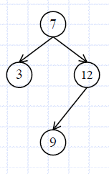
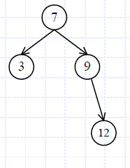
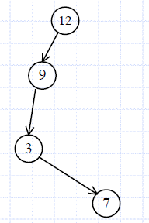
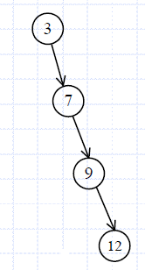
Binary Search Tree
Construct Binary Search Tree for 3, 7, 9, 12
The left subtree of a node contains only nodes with keys lesser than the node’s key.
The right subtree of a node contains only nodes with keys greater than the node’s key.
The left and right subtree each must also be a binary search tree.
Cost is associated for each node is equal to number of comparisons.
Number of trees with n nodes=
2nC_{n}
n+1

Slide 6
Optimal Binary Search Tree
a
b
c
d
number of comparisons in tree
  (1+2+2+3)/4 = 8/4 = 2
  (1+2+2+3)/4 = 8/4 = 2
  (1+2+3+4)/4 = 10/4 = 2.5
  (1+2+3+4)/4 = 10/4 = 2.5
Problem:
Construct a binary search tree who cost is less
This calculation assumes that each element is searched for with equal probability and that no unsuccessful searches are made. Because different elements/identifiers are searched with different probability/frequencies.

Slide 7
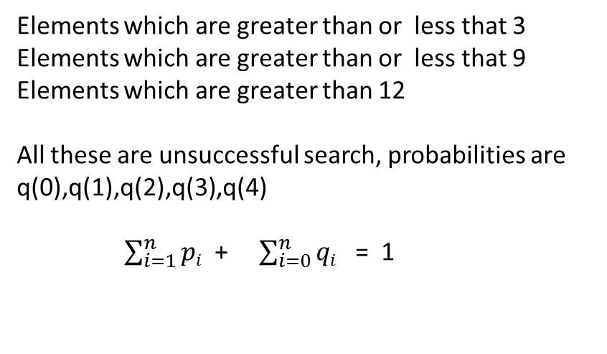
Optimal Binary Search Tree(OBST)
Let {a₁,a₂,….a_{n}} be the given set of identifiers/elements for constructing OBST with a₁<a₂<…………<a_{n.}
Let p_{i} be the probability for searching a_{i} (successful search)
Let q_{i} be the probability for searching x such that a_{i} < x < a_{i+1}(unsuccessful search) where 0<= i<=n
All these gives a successful search
Example: {do, if, int , while}={a₁,a₂, a_{3,} a₄} ={ 3,7,9,12}
p(1),p(2),p(3),p(4) are the probability of a₁,a₂, a_{3,} a₄
Elements which are greater than or less that 3
Elements which are greater than or less that 9
Elements which are greater than 12
All these are unsuccessful search, probabilities are
q(0),q(1),q(2),q(3),q(4)
$\sum_{i=1}^{n}{pi}$ + $\sum_{i=0}^{n}{qi}$ = 1

Slide 8
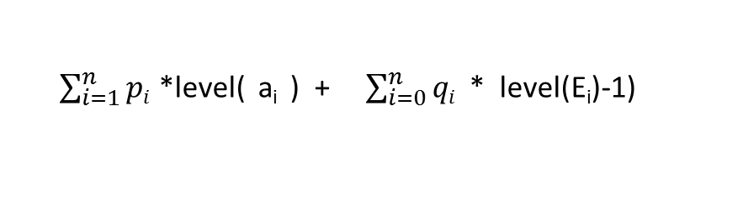
How to find the cost of the tree ?
The expected cost of the tree is:
$\sum_{i=1}^{n}{pi}$ *level( a_{i} ) + $\sum_{i=0}^{n}{qi}$ * level(E_{i})-1)
Successful search
unsuccessful search
E₀
E₁
E₄
E₂
E₃

Slide 9
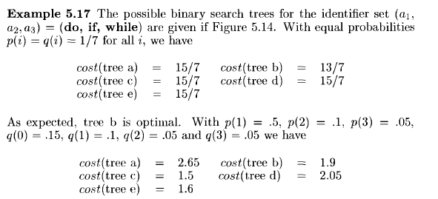
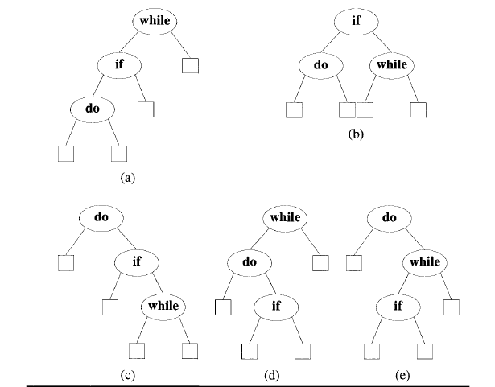
cost(tree, a) = (3 * 0.5+2*0.1+1*0.05) + (3 * 0.15+3 * 0.1+2 * 0.05+1*0.05) =1.75+ 0.90
=2.65
Level of the root is considered as ‘1’

Slide 10
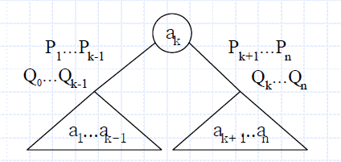
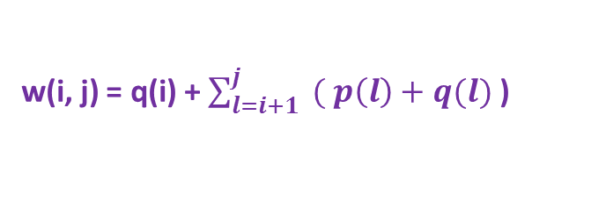
Optimal Binary Search Tree(OBST)
Consider that we want to construct OBST for elements a_{1,} a_{2,} …….,a_{n}
Cost of the tree c(0,n)= p(k) +
Cost of left subtree ie c(0,k-1)
+
Cost of right subtree ie c(k,n)
+
Probabilities of left subtree ie w(0,k-1)
+
Probabilities of right subtree ie w(k,n)
c(0,n) = min { c(0,k-1) + c(k, n) + p(k) + w(0,k-1) + w(k, n) }
1 ≤ k ≤ n
Generalize formula
c(i,j) = min { c(i,k-1) + c(k,j) + p(k) + w(i,k-1) + w(k,j) }
i < k ≤ j
c(i,j) = min { c(i,k-1) + c(k,j) }+ w(i,j)
i < k ≤ j
w(i, j) = q(i) + $\sum_{l=i+1}^{j}{ ( p\left(l\right)+q(l)}$ )

Slide 11
Optimal Binary Search Tree(OBST)
Consider that we want to construct OBST for elements a_{1,} a_{2,} a_{3 ,}a₄
Calculate C(0,4)
c(i,j) = min { c(i,k-1) + c(k,j) }+ w(i,j)
i < k ≤ j
a₃
K=3
C(0,4)
a₂
a₄
C(0,2)
C(3,4)
a₁
C(0,1)
Solve the problem in bottom up approach

Slide 12
Optimal Binary Search Tree(OBST)
If only one node exist in the tree. It may be ………..
a₁
a₂
a₃
a₄
E₀
E₁
E₁
E₂
E₂
E₃
E₃
E₄
C(0,1)
C(1,2)
C(2,3)
C(3,4)
In terms of c(i,j) j>i and j-i=1
So step 2 of OBST calculations we compute c(i, j ) such that j-i=1

Slide 13
Optimal Binary Search Tree(OBST)
a₁
a₂
C(0,2)
or
a₂
a₁
E₂
E₀
E₀
E₁
E₁
E₂
In step 3 of OBST calculations we compute c(i, j ) such that j-i=2 j>i
C(1,3)
C(2,4)
a₃
a₂
a₄
a₃
a₂
or
E₁
a₃
or
E₃
a₃
E₄
E₂
a₄
E₂
E₄
E₁
E₂
E₂
E₃
E₃
E₄

Slide 14
Optimal Binary Search Tree(OBST)
In step 4 of OBST calculations we compute c(i, j ) such that j-i=3 j>i
c(0,3), c(1,4)
In step 5 of OBST calculations we compute c(i, j ) such that j-i=4 j>i
c(0,4)
During this computation we record the root r(i,j) of each tree t_{ij}, then an optimal binary search tree can be constructed from these r(i,j).
r(i,j) is the value of k that minimize
Note: c(i,i) = 0 and w(i,i) = q(i) where 0 ≤ i ≤ n

Slide 15
Optimal Binary Search Tree(OBST)
Let n=4 and (a_{1,} a_{2,} a_{3 ,}a₄ ) =(do, if, int , while)
and p(1:4)=(3,3,1,1) and q(0:4)=(2,3,1,1,1)
In step 1
Initially w(i,i) =q(i) and c(i,i) =0 and r(i,i)=0 should be calculated for all i from 0 to 4
0
1
2
3
4
w(0,0)= q(0) = 2 c(0,0)=0 r(0,0)=0 | w(1,1)= q(1) = 3 c(1,1)=0 r(1,1)=0 | w(2,2)= q(2) = 1 c(2,2)=0 r(2,2)=0 | w(3,3)= q(3) = 1 c(3,3)=0 r(3,3)=0 | w(4,4)= q(4) = 1 c(4,4)=0 r(4,4)=0
0
remaining steps cont……….

Slide 16
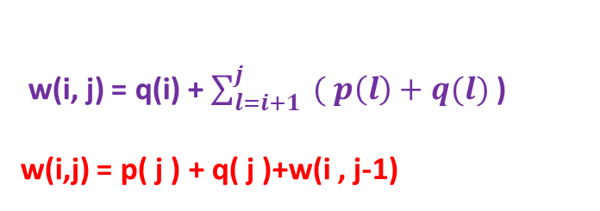
Optimal Binary Search Tree(OBST)
Let n=4 and (a_{1,} a_{2,} a_{3 ,}a₄ ) =(do, if, int , while)
and p(1:4)=(3,3,1,1) and q(0:4)=(2,3,1,1,1)
w(i, j) = q(i) + $\sum_{l=i+1}^{j}{ ( p\left(l\right)+q(l)}$ )
w(i,j) = p( j ) + q( j )+w(i , j-1)
Next compute j-i=1
c(0,1),c(1,2) c(2,3)c(3,4)
w(0,1),w(1,2) w(2,3)w(3,4)
r(0,1),r(1,2) r(2,3)r(3,4)
c(i,j) = min { c(i,k-1) + c(k,j)} + w(i,j)
i < k ≤ j
r(i,j ) = a_{k}
0
1
2
3
w(0,1)= 8 c(0,0)=0 r(0,0)=0
1
i=0
J=1
0<k<=1
w(0,1)= p(1)+q(1)+w(0,0)
= 3+3+2=8
c(0,1)= w(0,1) + min{ c(0,0)+c(1,1)}
= 8+0+0 =8
r(0,1)=1

Slide 17
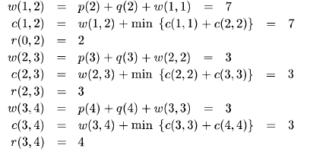

Slide 18
Optimal Binary Search Tree(OBST)
Let n=4 and (a_{1,} a_{2,} a_{3 ,}a₄ ) =(do, if, int , while)
and p(1:4)=(3,3,1,1) and q(0:4)=(2,3,1,1,1)
w(i, j) = q(i) + $\sum_{l=i+1}^{j}{ ( p\left(l\right)+q(l)}$ )
w(i,j) = p( j ) + q( j )+w(i , j-1)
Next compute j-i=1
c(0,1),c(1,2) c(2,3)c(3,4)
w(0,1),w(1,2) w(2,3)w(3,4)
r(0,1),r(1,2) r(2,3)r(3,4)
c(i,j) = min { c(i,k-1) + c(k,j)} + w(i,j)
i < k ≤ j
r(i,j ) = a_{k}
0
1
2
3
w(0,1)= 8 c(0,1)=8 r(0,1)=1 | w(1,2)= 7 c(1,2)=7 r(1,2)=2 | w(2,3)= 3 c(2,3)=3 r(2,3)=3 | w(3,4)= 3 c(3,4)=3 r(3,4)=4
1

Slide 19
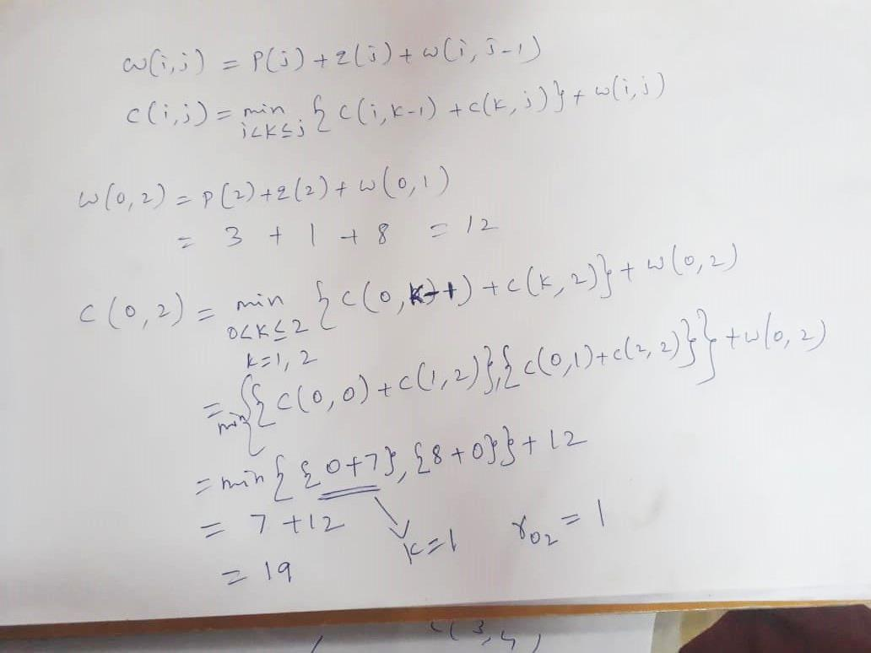

Slide 20
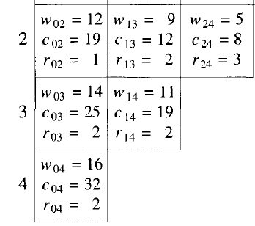
0
1
2
3
4
w(0,0)= q(0) = 2 c(0,0)=0 r(0,0)=0 | w(1,1)= q(1) = 3 c(1,1)=0 r(1,1)=0 | w(2,2)= q(2) = 1 c(2,2)=0 r(2,2)=0 | w(3,3)= q(3) = 1 c(3,3)=0 r(3,3)=0 | w(4,4)= q(4) = 1 c(4,4)=0 r(4,4)=0
0
w(0,1)= 8 c(0,1)=8 r(0,1)=1 | w(1,2)= 7 c(1,2)=7 r(1,2)=2 | w(2,3)= 3 c(2,3)=3 r(2,3)=3 | w(3,4)= 3 c(3,4)=3 r(3,4)=4
1
a₂
C(0,4)
C(0,1)
C(2,4)
a₃
a₁
a₄
C(2,2)
C(3,4)
(a_{1,} a_{2,} a_{3 ,}a₄ ) =(do, if, int , while)
E₂

Slide 21
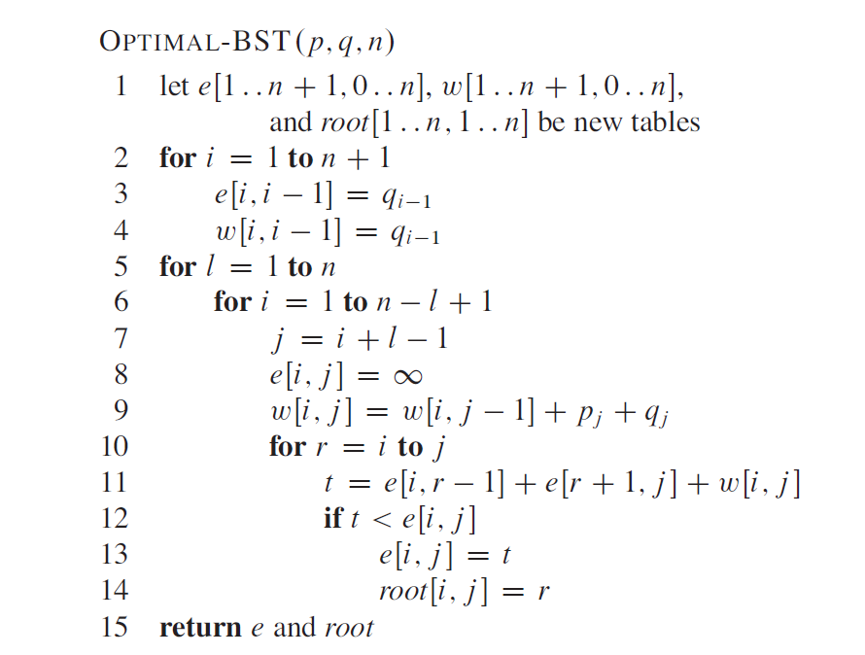
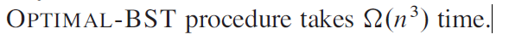
Algorithm for OBST

Slide 22
Applications of OBST
Huffman's code
Graph theory
ASCII string search
Natural language processing
State reduction

